Slide 1
Week of August 5, 2020
Quantum Troopers

Slide 2
Current Progress on
the Paper:
Wave Function Generation as Noise Evaluation

Slide 3
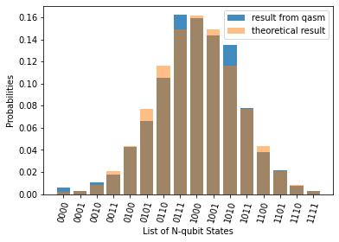
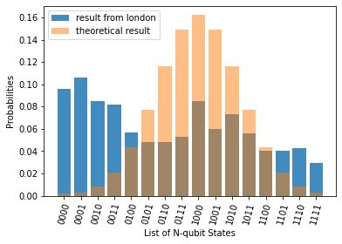
Individual Contributions: Completed
First draft of the introduction and algorithm section
Work done for the hackathon used Gaussian distributions
Further work has now been completed on using uniform distribution to benchmark noise

Slide 4
Individual Contributions: In Progress
Add on background information section to the paper
Investigation of error correction methods
Investigate mathematically how error from different sources might propagate into the gaussian
Run simulations on qiskit to see trace out of error v.s. Bit-reset noises
Index and label the different coupling map types that we have
Add an example of each graph with its label
Run the simulations for each error type and for the various chip layouts

Slide 5
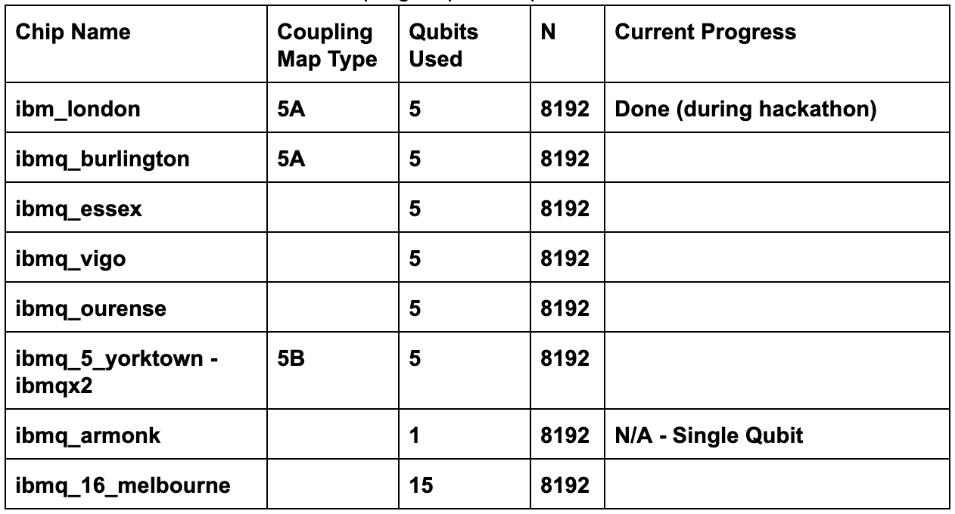
Chips to Run Algorithm On:

Slide 6
Kitaev-Webb Algorithm

Slide 7
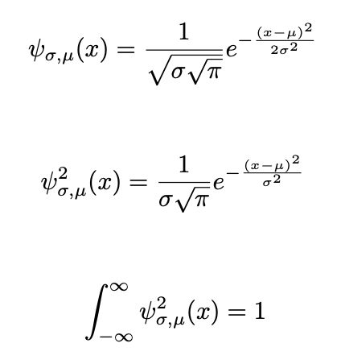
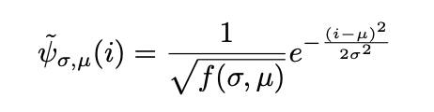
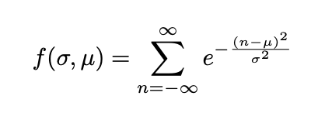
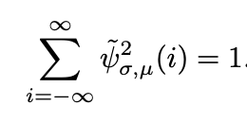
Preparing a Gaussian in One Dimension
Holding μ and σ fixed
What we create is actually a periodic discrete Gaussian quantum state

Slide 8
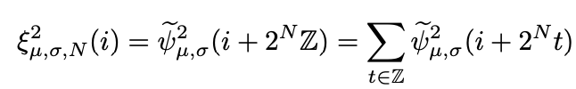
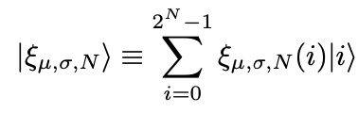

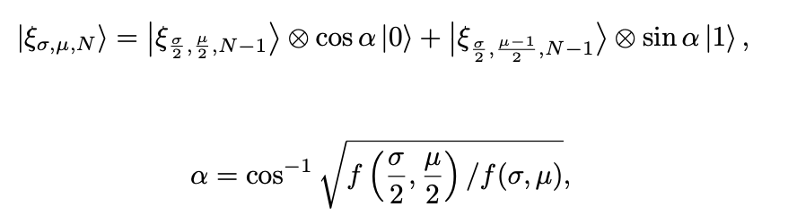
Preparing a Gaussian in One Dimension
Introduce mean, standard deviation, and number of qubits
Periodic with a period of 2^{N}, such that it will very nearly approximate a Gaussian wave function, which corresponds to the probability of getting some configuration of qubits
State is already normalized

Slide 9
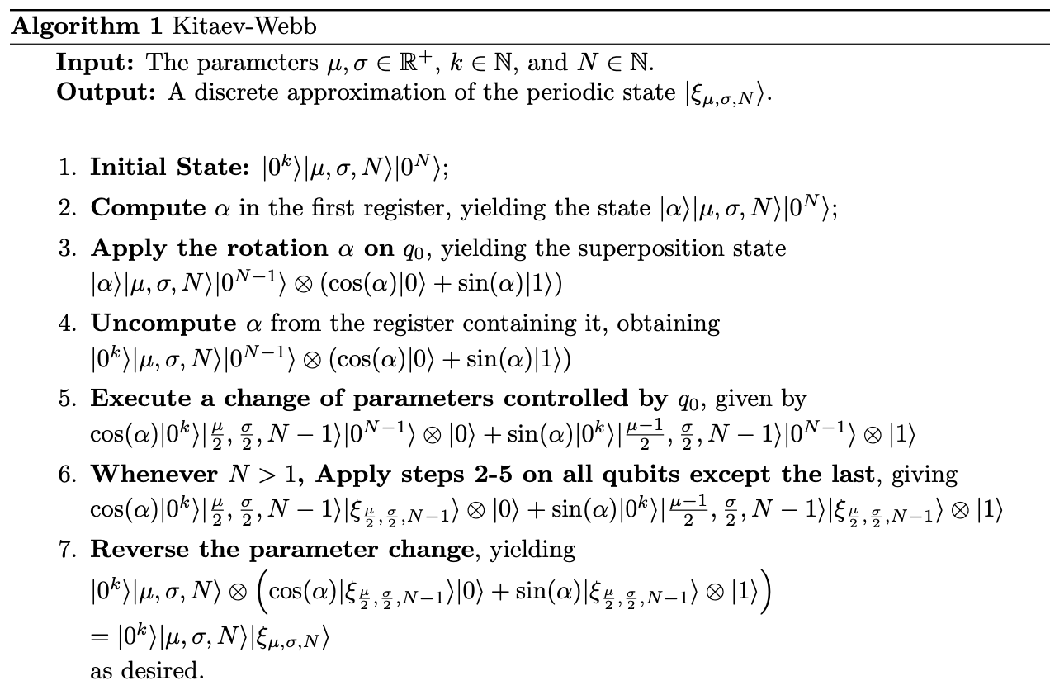
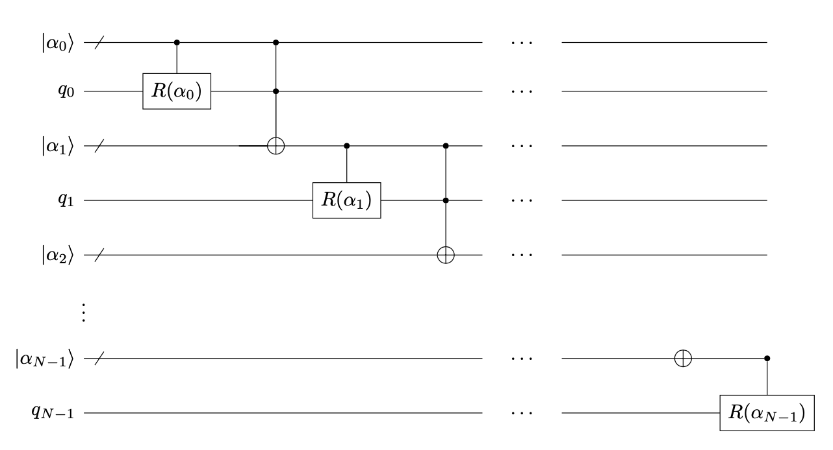
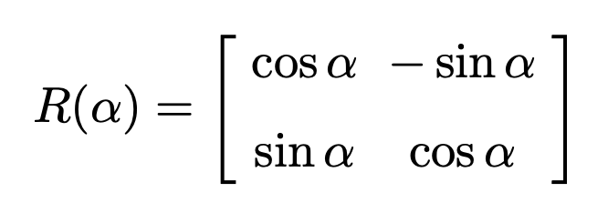
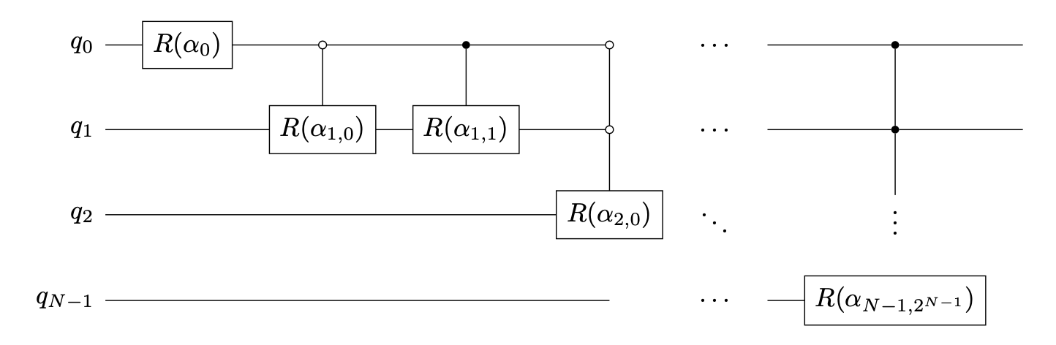
Preparing a Gaussian in One Dimension

